Slide 1
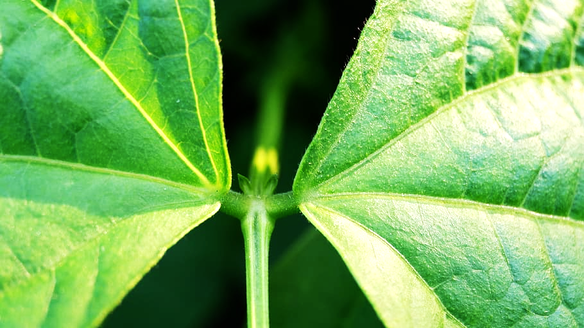
Our Experiment Investigates:
The effects of motor oil contamination in soil
on the sprouting success and growth rate
of Bush Beans plants

Slide 2
Our Experiment Investigates:
The effects of motor oil contamination in soil
on the sprouting success and growth rate
of Bush Beans plants

Slide 3



Our Hypothesis
Prediction: Increased motor oil levels = decreased plant growth and sprouting success.
Reasoning: Excess hydrocarbon concentration in soil reduce availability of things plants need for growth.

Slide 4
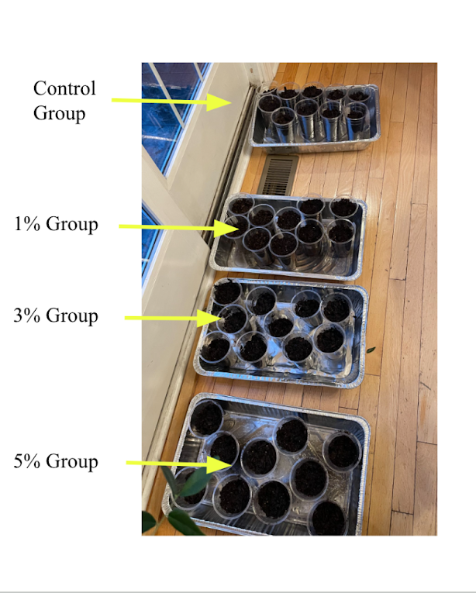
Our Test Groups
2 Trials – Joy and Shaurya Each
4 Groups in Each Trial
0% Oil in Soil (Control)
1% Oil in Soil
3% Oil in Soil
5% Oil in Soil
10 Bush Bean Plants in Each Group

Slide 5
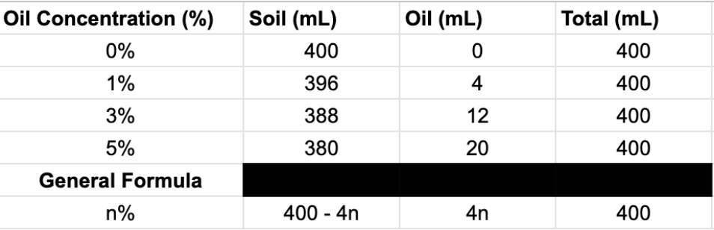
Steps to Contaminate Soil
Refer to the chart on the right for amounts of oil + soil
01
02
03
Place appropriate amount of soil in each group
Measure and pour corresponding amount of oil in each cup
Stir using a popsicle stick to incorporate the oil evenly into the soil

Slide 6
Steps to Contaminate Soil
01
02
03
Place appropriate amount of soil in each group
Measure and pour corresponding amount of oil in each cup
Stir using a popsicle stick to incorporate the oil evenly into the soil

Slide 7
Steps to Contaminate Soil
01
02
03
Place appropriate amount of soil in each group
Measure and pour corresponding amount of oil in each cup
Stir using a popsicle stick to incorporate the oil evenly into the soil
Then the beans were planted 1 in. deep

Slide 8
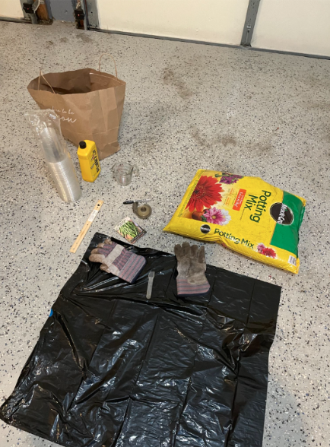
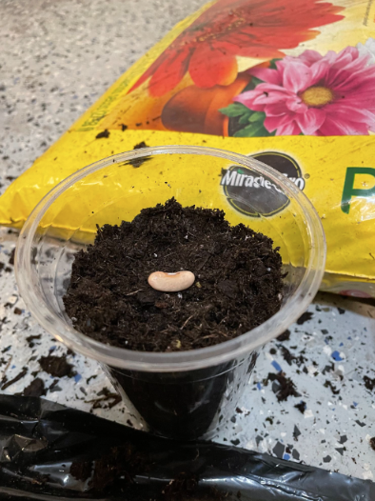
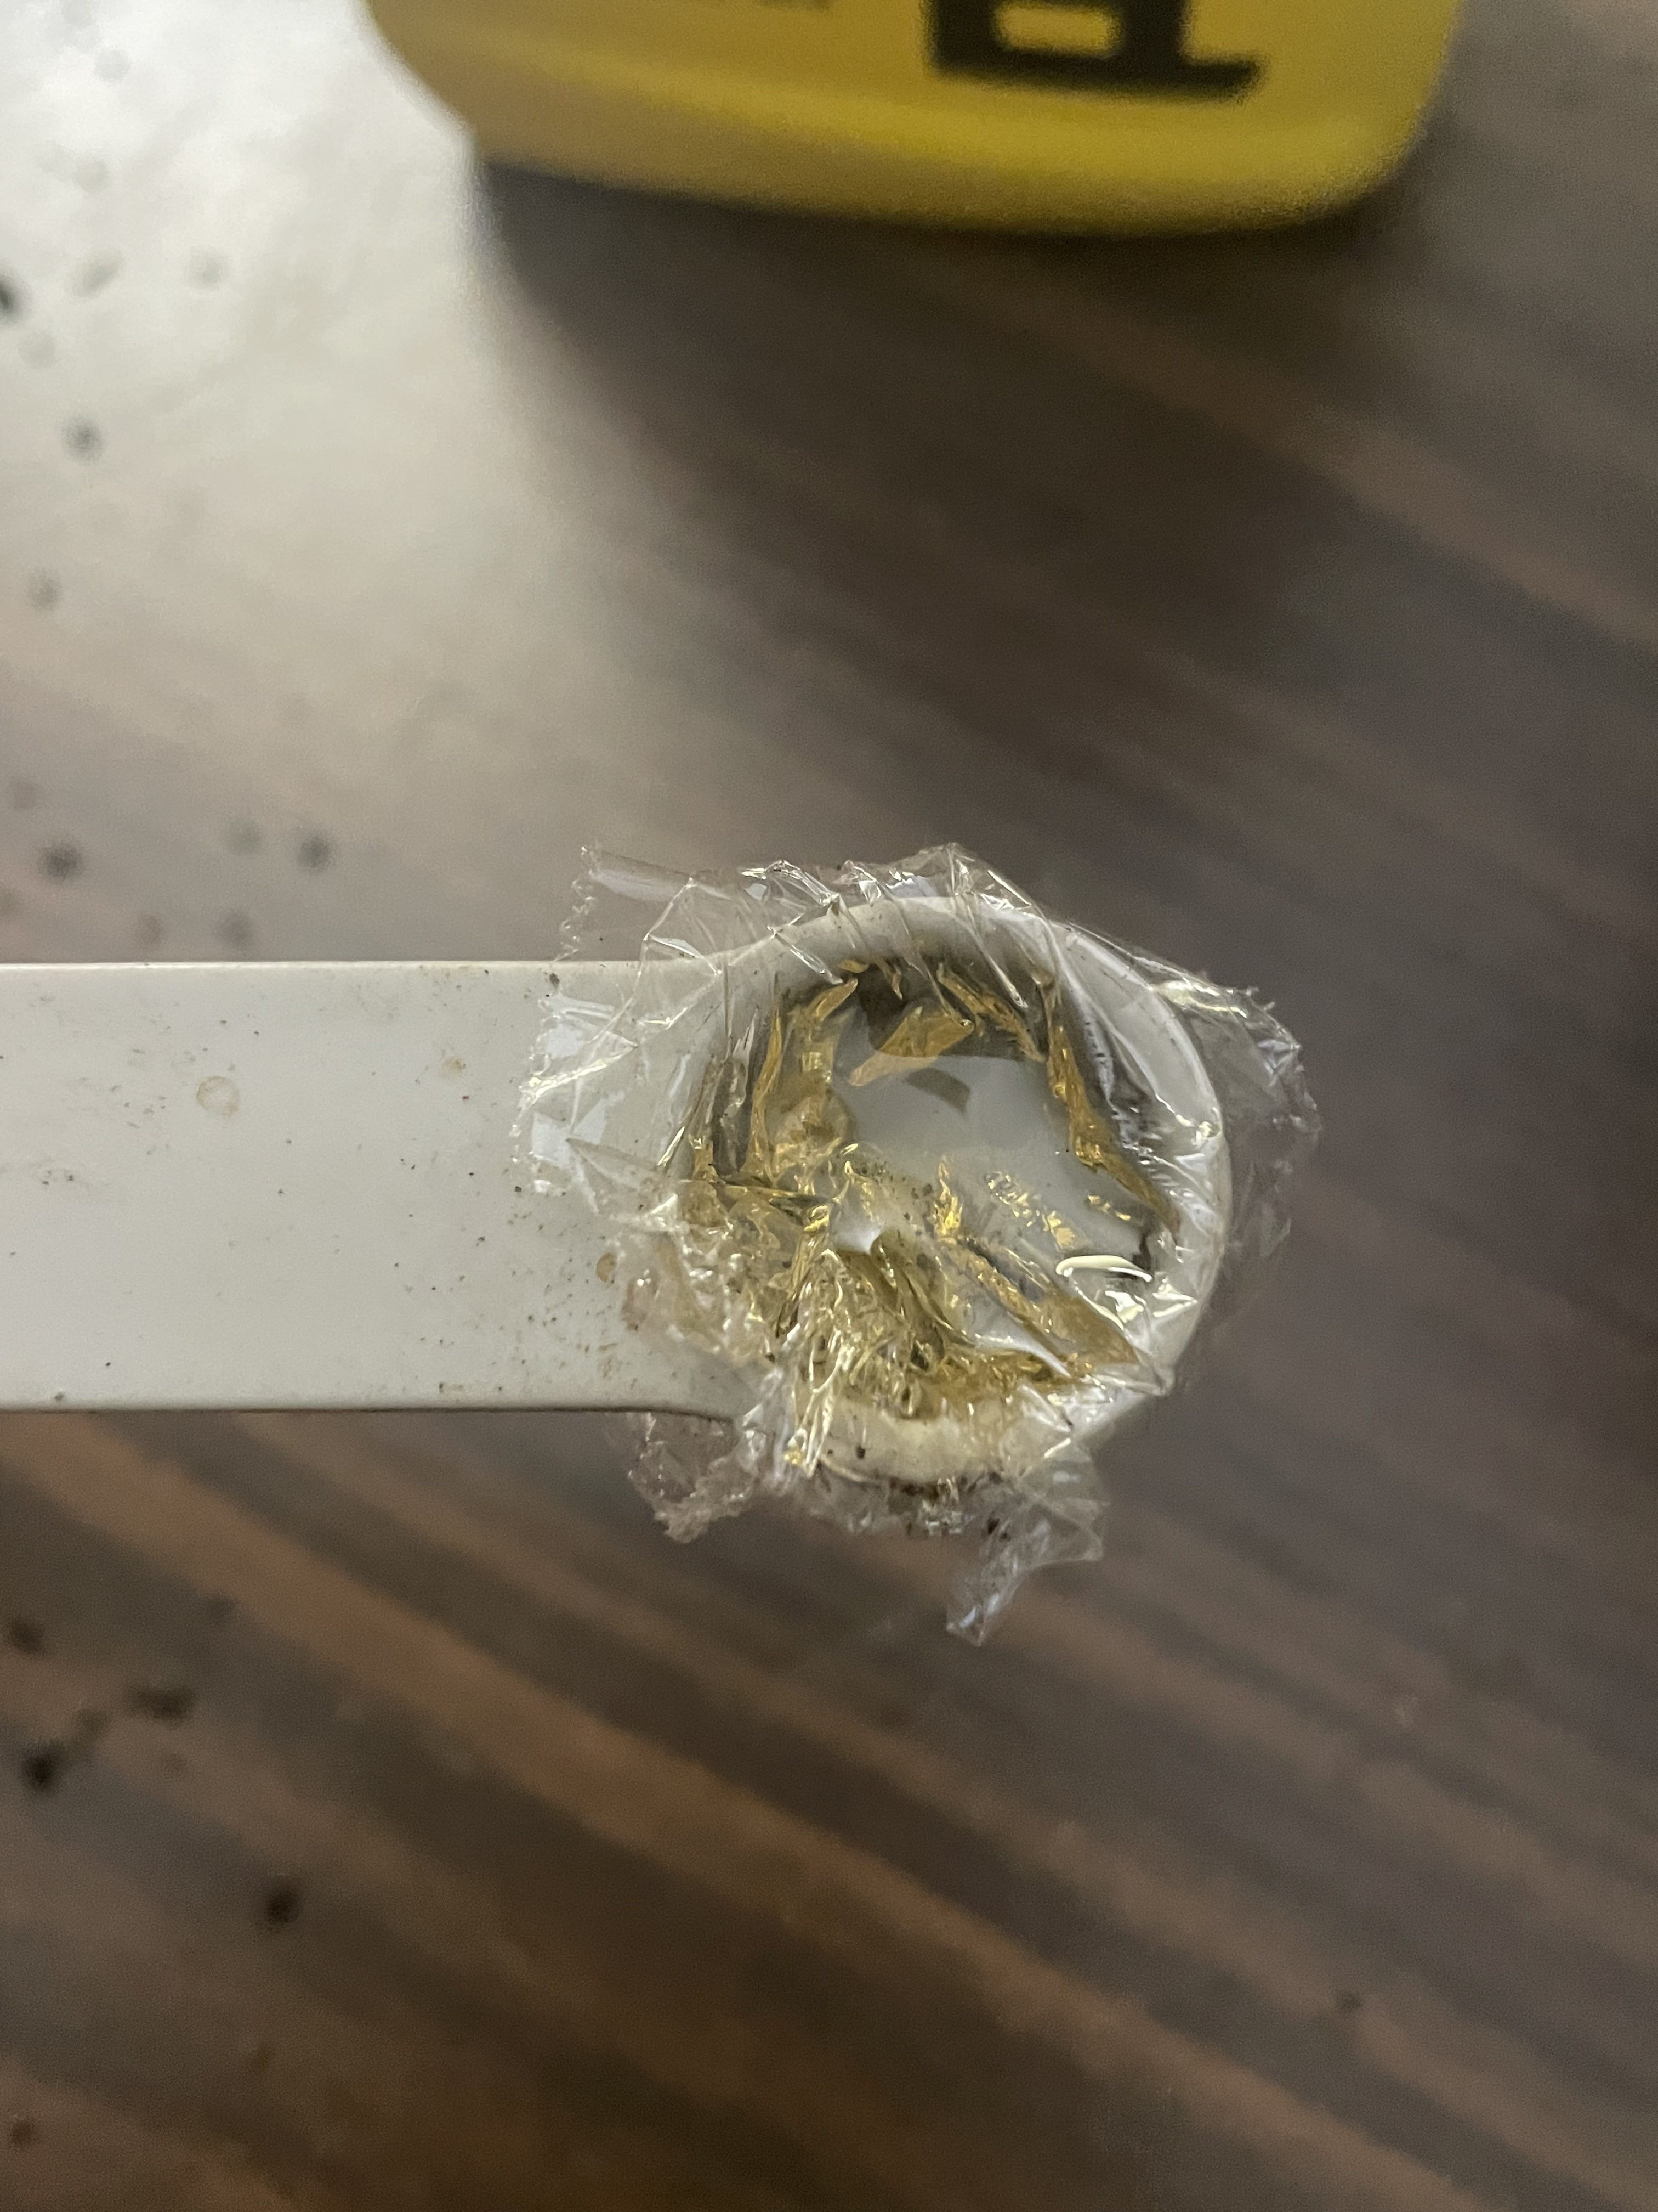
Pictures
Image of oil measurement (left)
Image of bush beans being planted (center)
Image of materials (right)

Slide 9
Data and Results
Disclaimer:
Joy’s trial was removed from the data set because her bush beans did not sprout until two weeks after the experiment started, abnormally late.

Slide 10
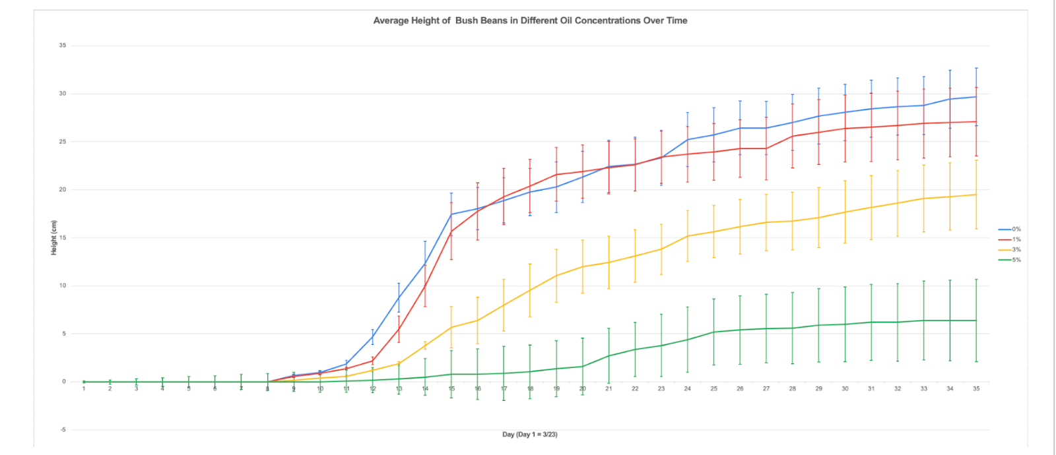
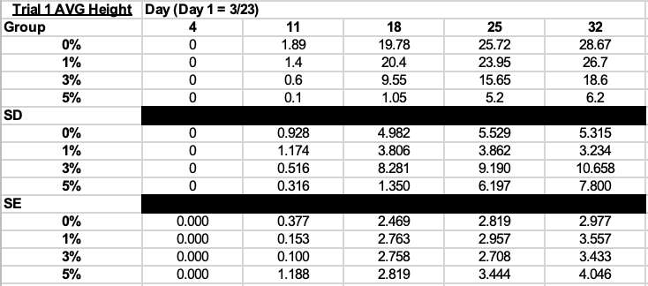
Data and Results
Observations:
Control and 1% Group have the highest height
3% have second highest height
5% have third highest height

Slide 11
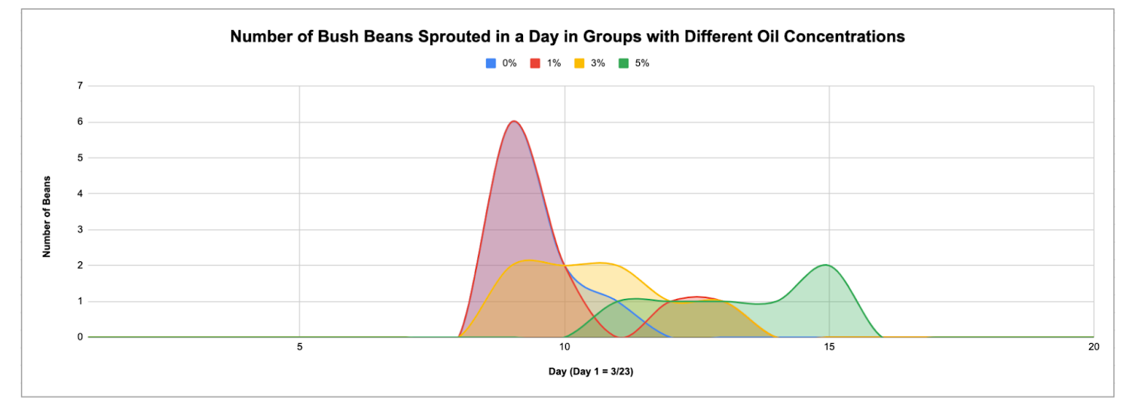
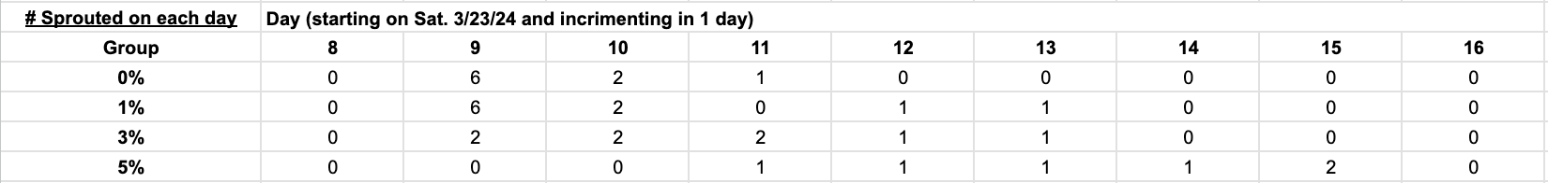
Data and Results
Observations:
Control and 1% follow similar sprouting trends
3% and 5% sprout later

Slide 12
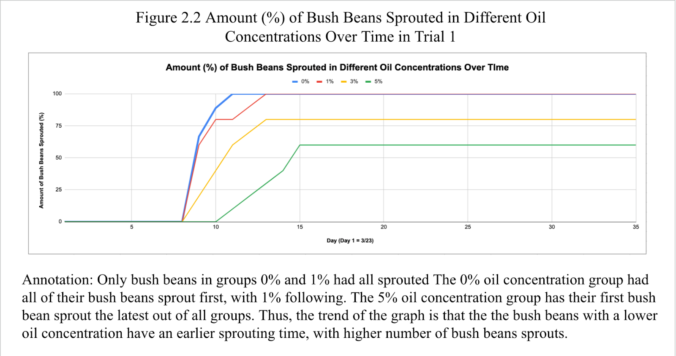
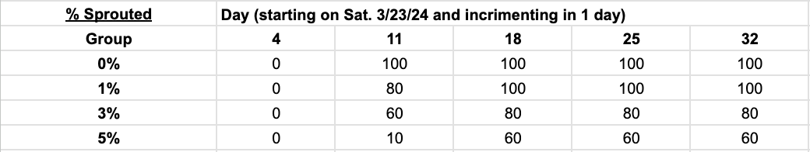
Data and Results
Observations:
Control group sprouts the earliest, reaches 100% sprouted first
1% group fully sprouts after
3% group sprouts third, but does not full sprout
5% has the least amount sprouted, and sprouts latest.

Slide 13
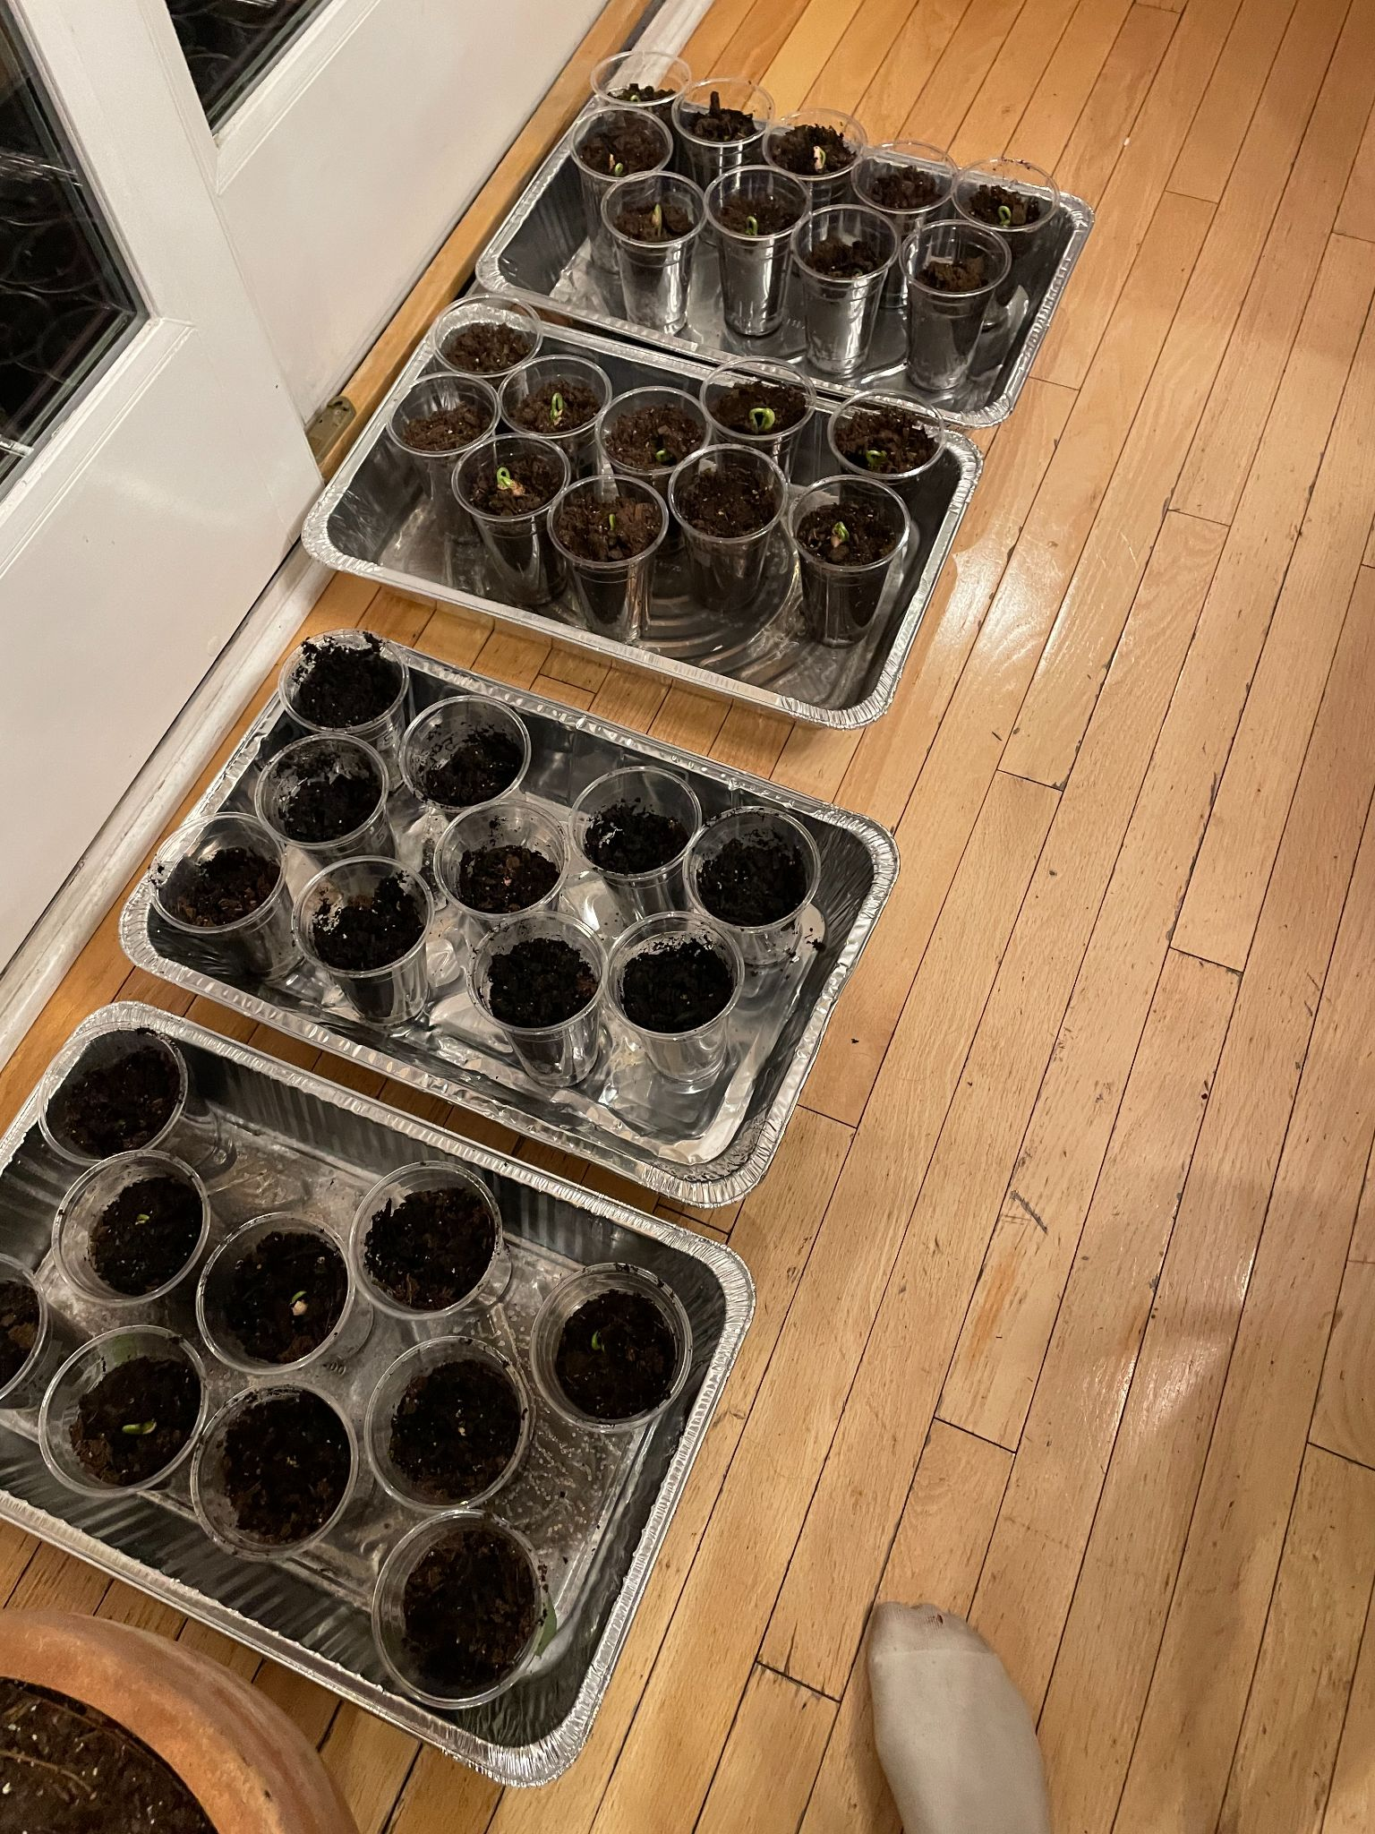
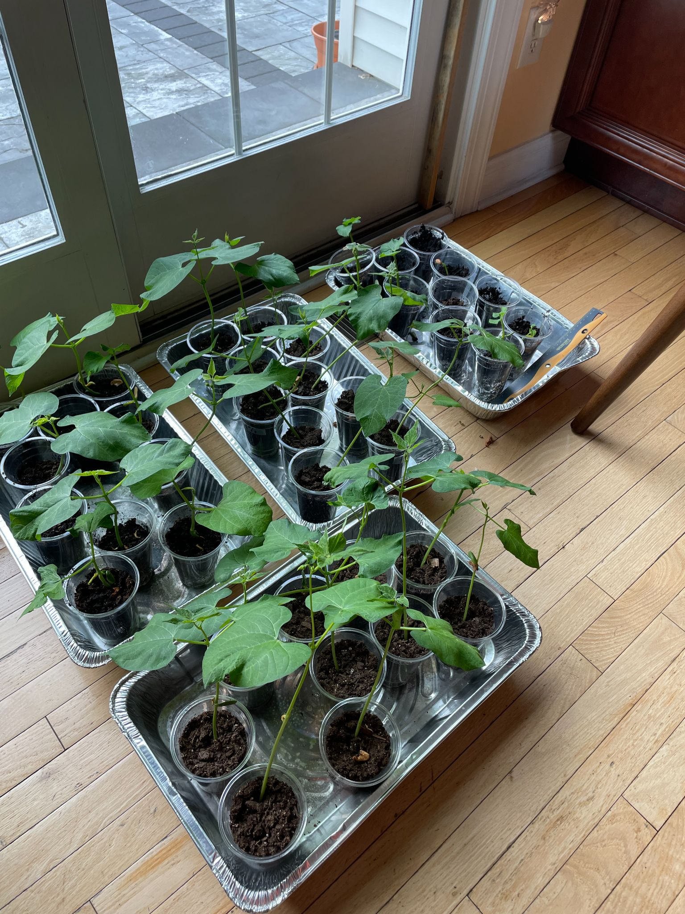

Data and Results
Day 11
Day 26

Slide 14
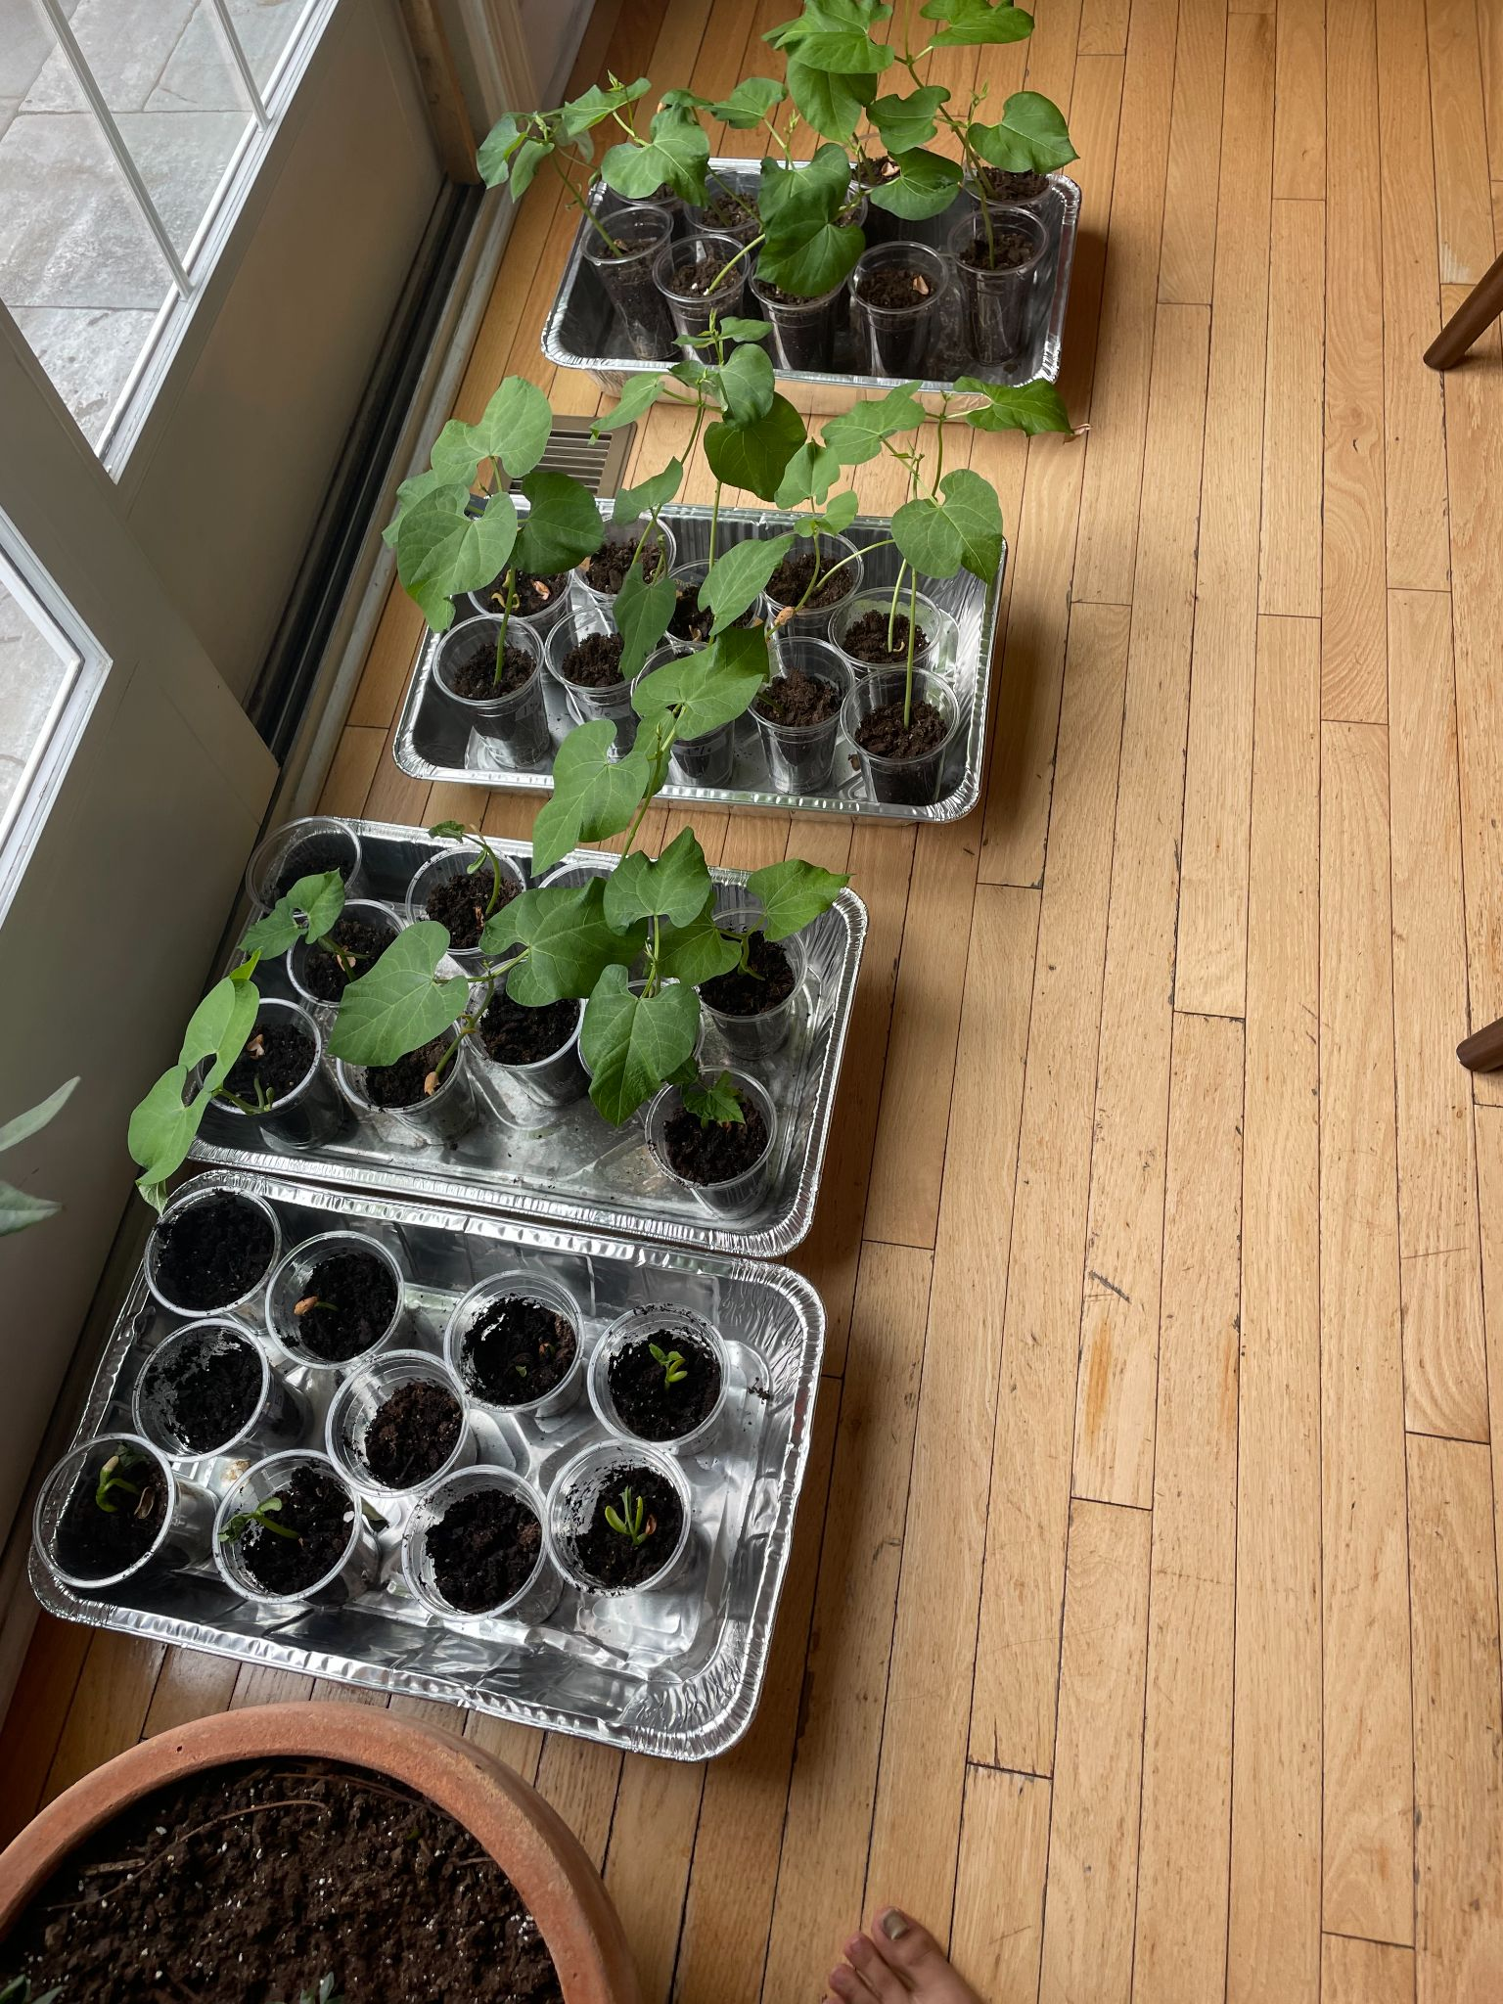
Data and Results
Overall, above 1%, as oil contamination percentage increases, bush bean plant height and sprouting success decrease.

Slide 15
Discussion
Our hypothesis was supported.

Slide 16
Why?
Discussion
Hydrocarbons in oil
decrease soil’s microbial diversity
Motor oil is hydrophobic
Oil contamination limits oxygen availability in plants
01
02
03

Slide 17
Why?
Discussion
Hydrocarbons in oil
decrease soil’s microbial diversity
Motor oil is hydrophobic
Oil contamination limits oxygen availability in plants
01
02
03

Slide 18
Why?
Discussion
Hydrocarbons in oil
decrease soil’s microbial diversity
Motor oil is hydrophobic
Oil contamination limits oxygen availability in plants
01
02
03

Slide 19
Why?
Discussion
Hydrocarbons in oil
decrease soil’s microbial diversity
Motor oil is hydrophobic
Oil contamination limits oxygen availability in plants
01
02
03

Slide 20
Needed for nutrient cycling and growth stimulation
Inhibits microbe activity
Large presence of oil
No electrons in ETC for photosynthesis
Soil can’t absorb H₂O
Hydrophobic
Aerobic respiration impaired
O₂ inaccessible
Coats roots

Slide 21
Inhibits microbe activity
Needed for nutrient cycling and growth stimulation
Large presence of oil
No electrons in ETC for photosynthesis
Soil can’t absorb H₂O
Hydrophobic
Aerobic respiration impaired
O₂ inaccessible
Coats roots

Slide 22
Inhibits microbe activity
Needed for nutrient cycling and growth stimulation
Large presence of oil
Hydrophobic
Soil can’t absorb H₂O
No electrons in ETC for photosynthesis
Aerobic respiration impaired
O₂ inaccessible
Coats roots

Slide 23
Inhibits microbe activity
Needed for nutrient cycling and growth stimulation
Large presence of oil
Hydrophobic
Soil can’t absorb H₂O
No electrons in ETC for photosynthesis
Aerobic respiration impaired
O₂ inaccessible
Coats roots

Slide 24
Inhibits microbe activity
Needed for nutrient cycling and growth stimulation
Large presence of oil
Hydrophobic
Soil can’t absorb H₂O
No electrons in ETC for photosynthesis
Aerobic respiration impaired
Coats roots
O₂ inaccessible

Slide 25
Inhibits microbe activity
Needed for nutrient cycling and growth stimulation
Large presence of oil
Hydrophobic
Soil can’t absorb H₂O
No electrons in ETC for photosynthesis
Coats roots
O₂ inaccessible
Aerobic respiration impaired

Slide 26

Discussion
Why does this matter?

Slide 27
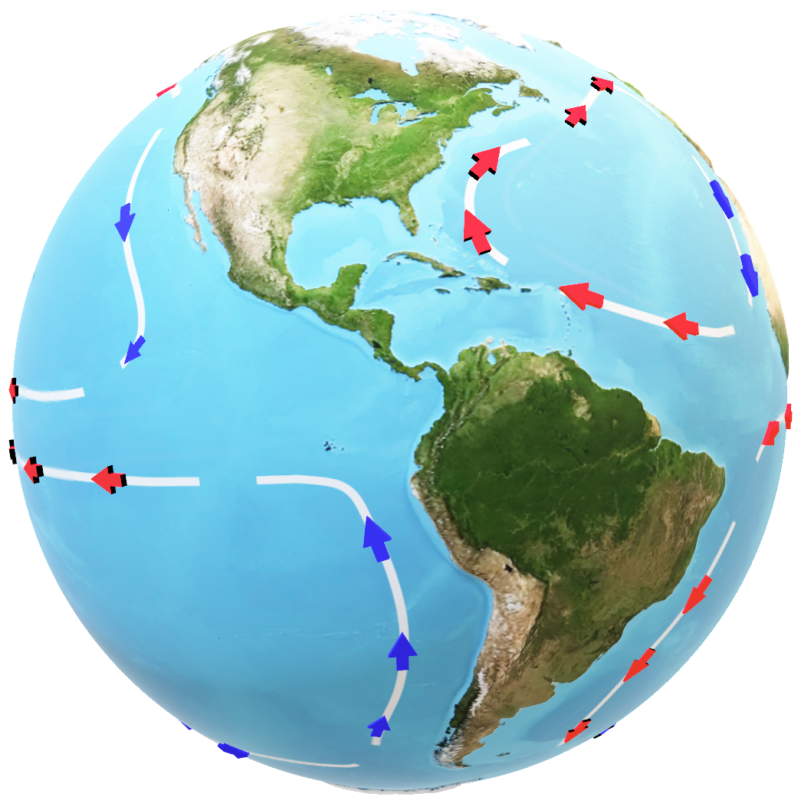
Our World and Pollution
Industrialization
Population growth

Slide 28
Summary
Motor oil contamination, specifically above 1% concentration, negatively affects bush bean plant growth and sprouting.
Because oil decreases:
Microbial activity
Water absorption
Oxygen
Important to mitigate oil contamination.

